Slide 1
Software engineering Object-oriented se using uml, patterns and java
Dan CHIOREAN
Lecture 4 – The Analysis model – based on Bernd Bruegge’s book

Slide 2
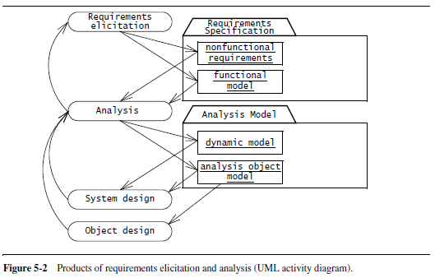
An Overview of Analysis
Analysis focuses on producing a model of the system, called the analysis model, which is correct, complete, consistent and verifiable.
Analysis is different from requirements elicitation in that developers focus on structuring and formalizing the requirements elicited from users.
The formalization leads to new insights and to discovery of errors in requirements.

Slide 3
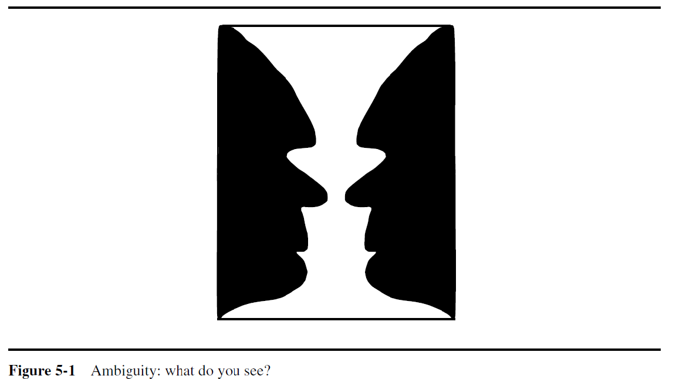
Challenges in Model Analysis
Formalization helps identify areas of ambiguity as well as inconsistencies and omissions in a requirements specification. Once developers identify problems with the specification, they address them by eliciting more information from the users and the client. Requirements elicitation and analysis are iterative and incremental activities that occur concurrently

Slide 4
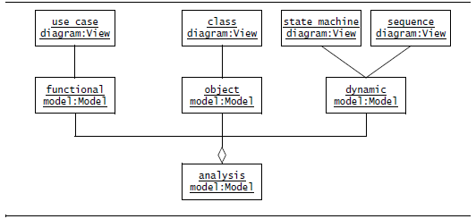
The Analysis Model

Slide 5
Analysis Object and Dynamic Views
The Analysis Object View consists of entity, boundary and control objects
Entity objects represent the persistent information tracked by the system
Boundary objects represent the interaction between the actors and the system
Control objects are in charge of realizing use cases
Example: In the 2Bwatch example, Time is the entity object, PushButton and LCDDisplay are boundary objects, Watch is a control object that represents the activity of changing the time by pressing combination of buttons

Slide 6
Analysis Object and Dynamic Views

Slide 7
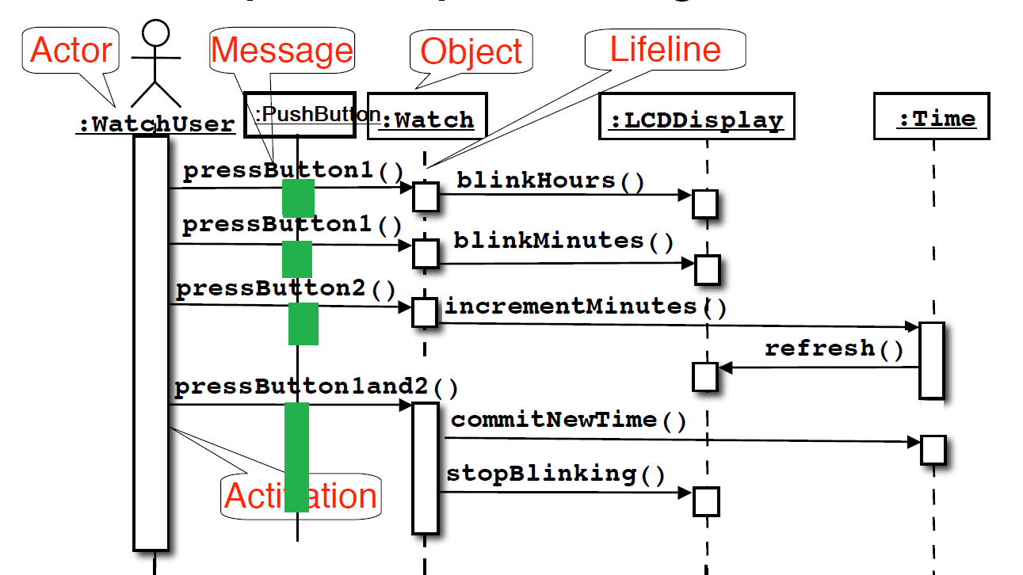
Analysis Object and Dynamic Views

Slide 8
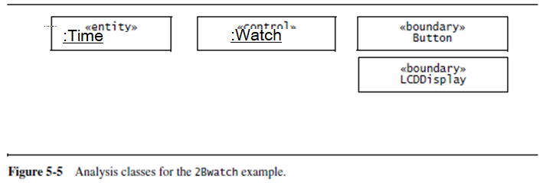
Analysis Object and Dynamic Views/2
To distinguish between different types of objects, UML provides the stereotype mechanism to enable the developer to attach such meta-information to modeling elements.

Slide 9
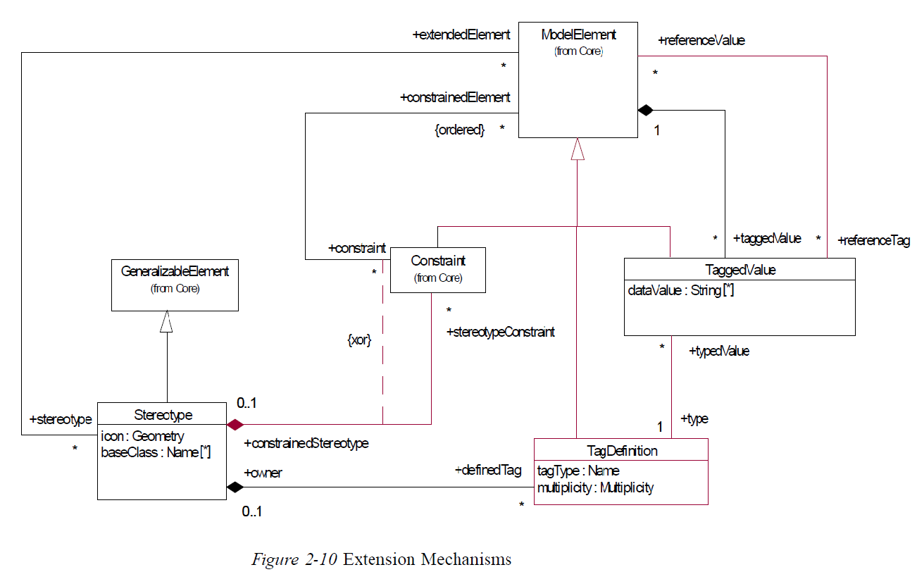
Stereotype an UML Extension Mechanisms

Slide 10
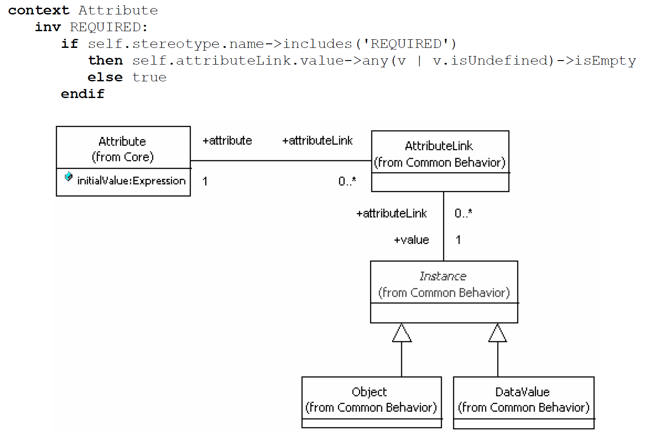
Managing Stereotypes in OCLE

Slide 11
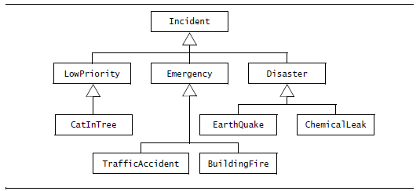
Analysis Object and Dynamic Views – Generalization and Specialization
In both cases, generalization and specialization result in the specification of inheritance relationships between concepts. In some instances, modelers call inheritance relationships generalization-specialization relationships. In Bruegge’s book, inheritance is used to denote the relationship and terms “generalization” and “specialization” to denote activities that find inheritance relationships.

Slide 12
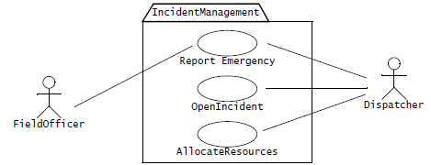
The FRIEND system (book pp. 68)
FRIEND – an accident management system in which field officers such as police officer or fire fighter have access to a wireless computer that enable the to interact with a dispatcher. The dispatcher in turn can visualize the current state of all its resources such as police cars or trucks, on a computer screen and dispatch a resource by issuing commands from a workstation.

Slide 13
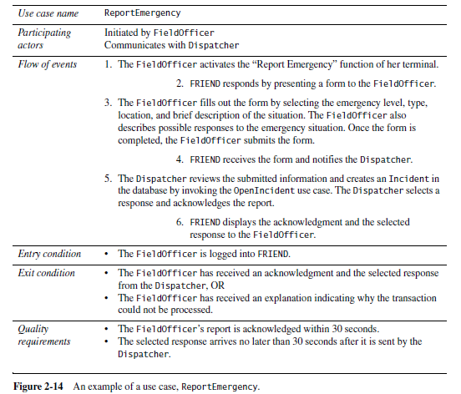
The FRIED system - cont

Slide 14
Analysis Activities: From Use Cases to Objects
Identifying Entity Objects,
Identifying Boundary Objects,
Identifying Control Objects,
Mapping Use Cases to Objects with Sequence Diagrams
Mapping Interactions among Objects with CRC Cards
Identifying Associations
Identifying Aggregates
Identifying Attributes
Modeling State-Dependent Behavior of Individual Objects
Modeling Inheritance Relationships
Reviewing the Analysis Model

Slide 15
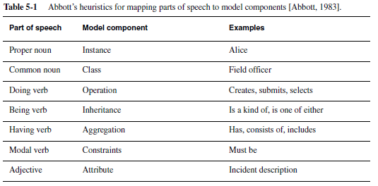
Abbot’s heuristics - mapping parts of speech to model components

Slide 16
Analysis Activities: Identifying Entity Objects
Heuristics for identifying entity objects
Terms that developers or users need to clarify in order to understand the use case
Recurring nouns in the use case (e.g. Incident)
Real-world entities that the system needs to track (e.g. FieldOfficer, Dispatcher, Resource)
Real-world activities that the system needs to track (e.g. EmergencyOperationsPlan)
Data sources or sinks (e.g. Printer)

Slide 17
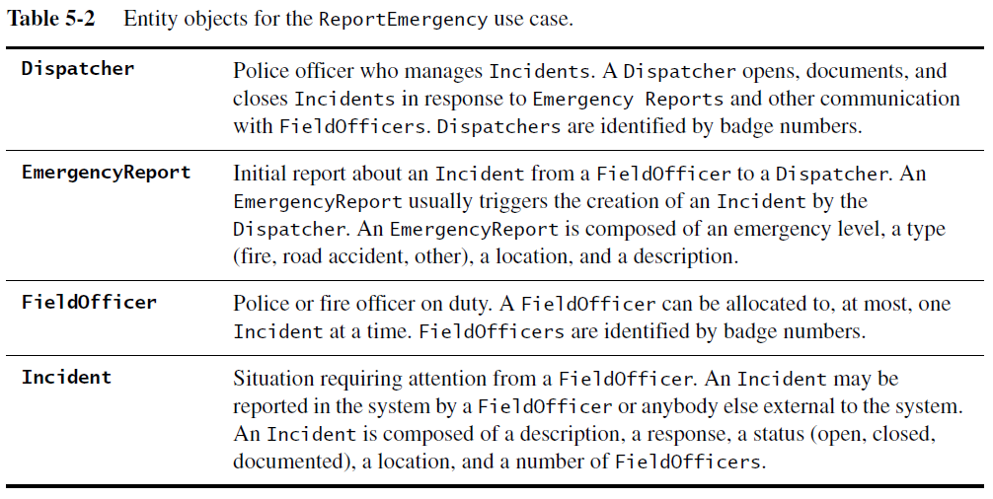
Analysis Activities: Identifying Entity Objects/2

Slide 18
Analysis Activities: Identifying Boundary Objects
Heuristics for identifying boundary objects
Identify user interface controls that the user needs to initiate the use case (e.g., ReportEmergencyButton)
Identify forms the users need to enter data into the system (e.g., EmergencyReportForm)
Identify notices and messages the system uses to respond to the user (e.g. AcknoledgmentNotice)

Slide 19
Analysis Activities: Identifying Boundary Objects/2
Heuristics for identifying boundary objects
When multiple actors are involved in a use case, identify actor terminals (e.g., DispatcherStation) to refer to the user interface under consideration
Do not model the visual aspects of the interface with boundary objects (user mock-ups are better suited for that)
Always use the end user’s terms for describing interfaces; do not use terms from the solution or implementation domains.

Slide 20
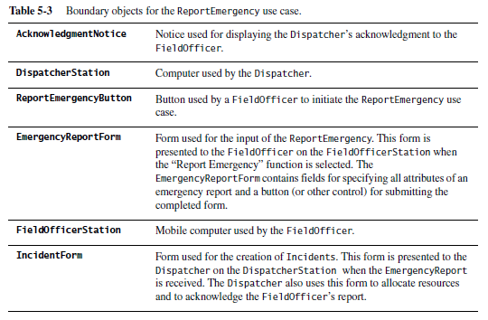
Analysis Activities: Identifying Boundary Objects/3

Slide 21
Analysis Activities: Identifying ControlObjects Heuristics for identifying control objects
Identify one control object per use case
Identify one control object per actor in the use case
The life span of a control object should cover the extent of the use case or the extent of a user session. If it is difficult to identify the beginning and the end of a control object activation, the corresponding use case probably does not have well-defined entry and exit conditions

Slide 22
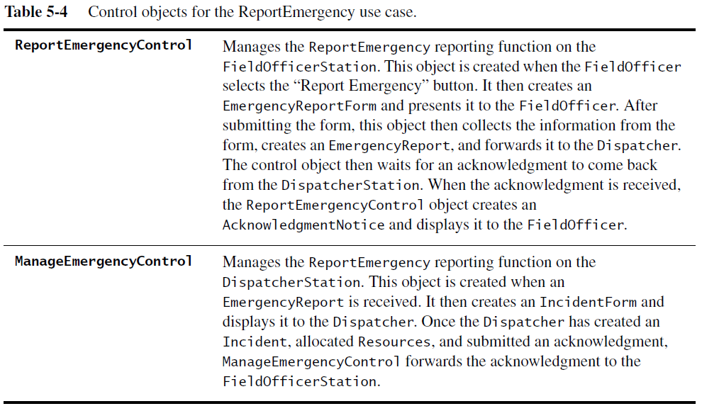
Analysis Activities: Identifying Control Objects/2

Slide 23
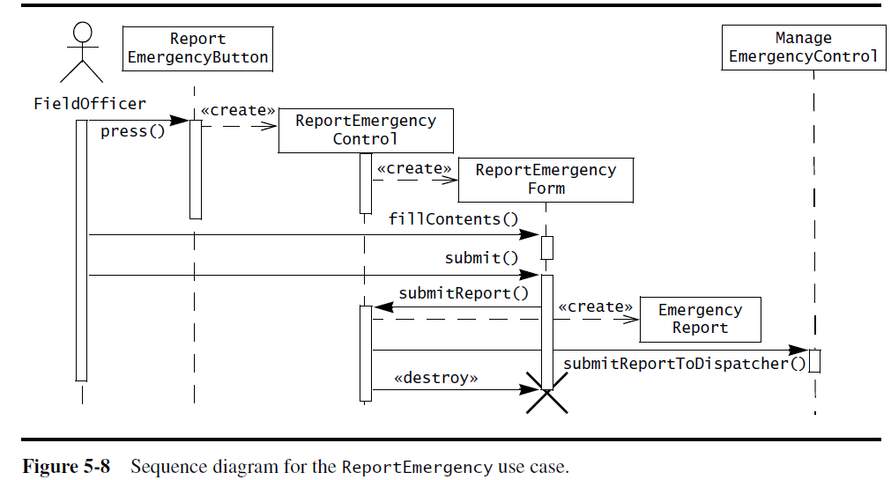
Mapping Use Cases to Objects with Sequence Diagrams
A sequence diagram ties use cases with objects. It shows how the behavior of a use case (or scenario) is distributed among participating objects.

Slide 24
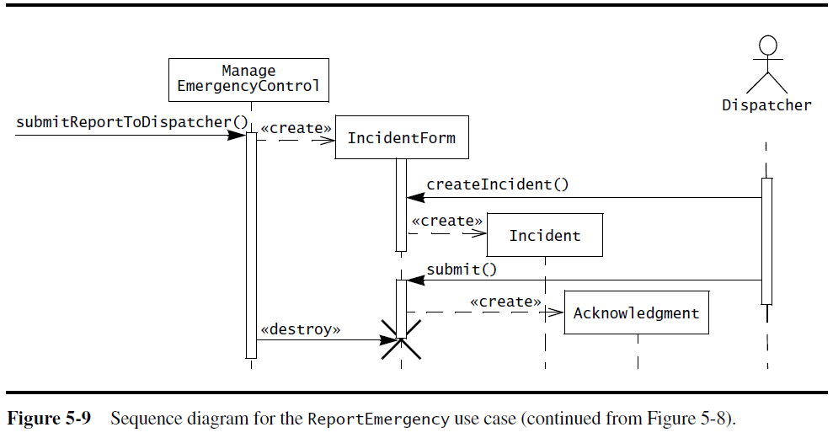
Mapping Use Cases to Objects with Sequence Diagrams_2

Slide 25
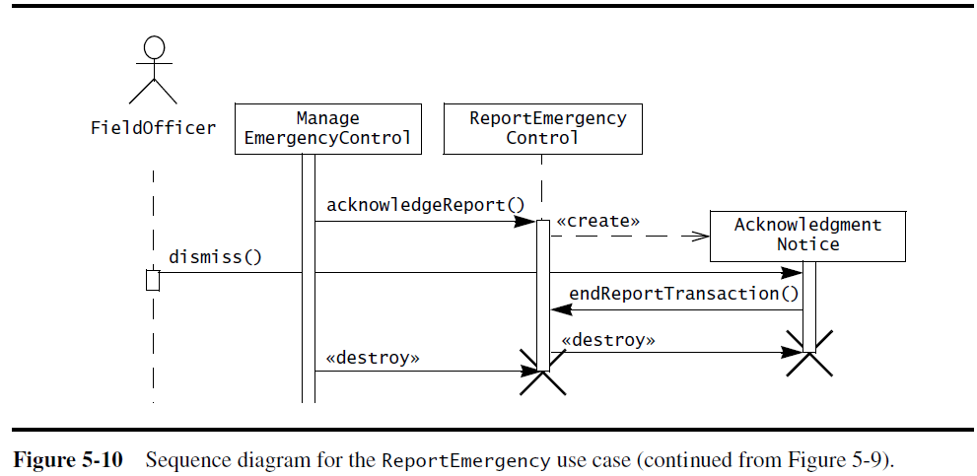
Mapping Use Cases to Objects with Sequence Diagrams_3
Sequence diagrams allow the developers to find missing objects or grey areas in the requirements specification.

Slide 26
Mapping Use Cases to Objects with Sequence Diagrams
Heuristics for drawing sequence diagrams
The first column should correspond to the actor who initiated the use case.
The second column should be a boundary object (that the actor used to initiate the use case).
The third column should be the control object that manages the rest of use case.

Slide 27
Mapping Use Cases to Objects with Sequence Diagrams/2
Heuristics for drawing sequence diagram
Control objects are created by boundary objects initiating use cases.
Boundary objects are created by control objects.
Entity objects are accessed by control and boundary objects.
Entity objects never access boundary or control objects; this makes it easier to share entity objects across use cases.

Slide 28
Modeling interactions among Objects with CRC Cards
An alternative for identifying interactions among objects are CRC cards [Beck & Cunningham, 1989]. CRC cards (class, responsibilities, collaborators) were initially introduced as a tool for teaching object-orientation concepts to novices and to experienced developers unfamiliar with object-orientation.

Slide 29
Modeling interactions among Objects with CRC Cards/2
Each class is represented with an index card. The name of the class is depicted on the top, its responsibilities on the left column, and the name of the classes it needs to accomplish the responsibilities are depicted on the right column.
CRC cards and sequence diagrams are two different representations for supporting the same type of activity.

Slide 30
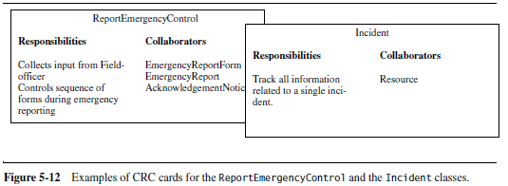
Modeling interactions among Objects with CRC Cards/3
Sequence diagrams are a better tool for a single modeler or for documenting a sequence of interactions because are more precise and compact. CRC cards are a better tool for a group of developers refining and iterating over an object structure during a brainstorming session because are easier to create and to modify.

Slide 31
Identifying associations
An association shows a relationship between two or more different objects instantiated by the same class (recursive association) or by different classes.
Identifying associations has two advantages:
It clarifies the analysis model by making relationships between objects explicit (e.g. , an EmergencyReport can be created by a FieldOfficer or a Dispatcher).
It enables the developer to discover boundary cases associated with links. Boundary cases are exceptions that must be clarified in the model.

Slide 32
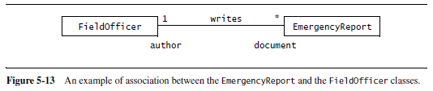
Identifying associations/2
Association have several properties:
Associations names are optional and need not to be unique globally.
A role at each end, identifying the function of each class’ instances with respect to the instances of the opposite end (e.g., author is the role played by FieldOfficer in relation with EmergencyReport.
A multiplicity at each end, identifying the possible number of instances.

Slide 33
Identifying associations/3 Heuristics for identifying associations
Examine verb phrases
Name associations and roles as suggestive as possible
Use qualifiers as often as possible to identify namespaces and key attributes
Eliminate any association that can be derived from other associations
Do not worry about multiplicity until the set of associations is stable
Too many associations make a model unreadable

Slide 34
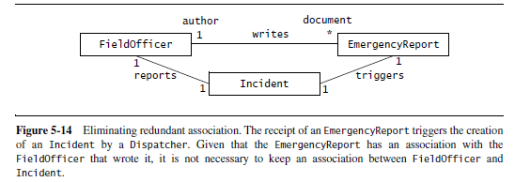
Identifying associations/4 Identifying Aggregates
Aggregations are special types of associations denoting a whole-part relationship.
There are two types of aggregations: composition and shared.

Slide 35
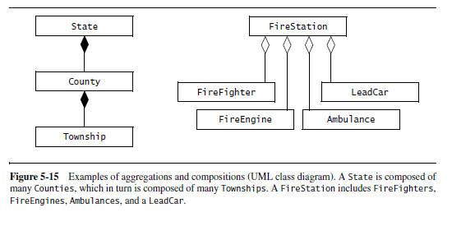
Identifying associations/5 Identifying Aggregates
A solid diamond denotes composition. A composition indicates that the existence of the parts depends on the whole
A shared aggregation relationship indicate that the whole and the parts can exist independently

Slide 36
Identifying Attributes
Attributes are properties of individual objects
When identifying properties of objects, only the attributes relevant to the system should be considered.
Properties that are represented by objects are not attributes
Developers should identify as many associations as possible before identifying attributes to avoid confusing attributes and objects.

Slide 37
Identifying Attributes/2
Attributes have:
A name identifying them within an object
A brief description
A type describing the legal values it can take

Slide 38
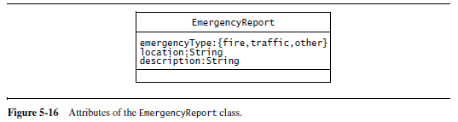
Identifying Attributes/3 Heuristics for identifying attributes
Examine possessive phrases.
Represent stored state as an attribute of the entity object.
Describe each attribute.
Do not represent an attribute as an object; use an association instead
Do not waste time describing fine details before the object structure is stable.

Slide 39
Modeling State-Dependent Behavior of Individual Objects
Statechart diagrams represent behavior from the perspective of a single object. Viewing behavior from the perspective of each object enable the developer to build a more formal description of the behavior of the object, and consequently, to identify missing use cases.
By focusing on individual states, developers may identify new behavior. By examining each transition in the statechart diagram that is triggered by a user action that triggers the transition.

Slide 40
Modeling State-Dependent Behavior of Individual Objects_2
Only objects with an extended lifespan and state-dependent behavior are worth considering. This is almost always the case for control objects, less often for entity objects, and almost never for boundary objects.

Slide 41
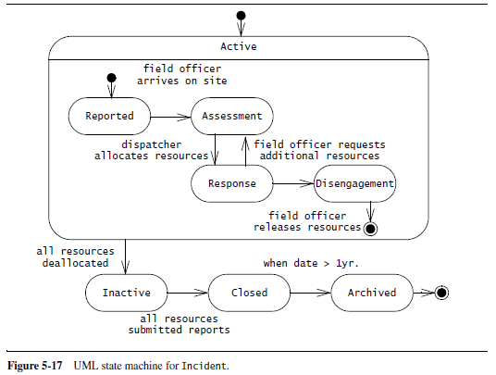
Modeling State-Dependent Behavior of Individual Objects/3

Slide 42
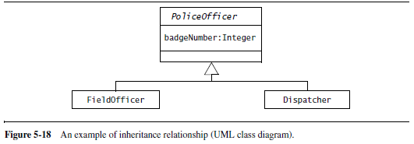
Modeling Inheritance Relationships between Objects
Generalization is used to eliminate redundancy from the analysis model. If two or more classes share attributes or behavior, the similarities are consolidated into an ascendent class. Both Dispatchers and FieldOfficers have a badgeNumber attribute that serves to identify them within a city. To model this similarity, we introduce an abstract PoliceOfficer class.

Slide 43
Reviewing the Analysis Model
The analysis model is built incrementally and iteratively. This model is seldom correct or even complete on the first pass. Before the analysis model converges toward a correct specification usable by the developers for design and implementation, several iterations with the client and the user are necessary.
Once the analysis model becomes stable (i.e., when the number of changes to the models are minimal and the scope of the changes localized), the analysis model is reviewed, first by the developers (i.e., internal reviews), then jointly by the developers and the client.

Slide 44
Reviewing the Analysis Model/2
The goal of the review is to make sure that the requirements specification is correct, complete, consistent and unambiguous.
Developers should be prepared to discover errors downstream and make changes to the specification.

Slide 45
Reviewing the Analysis Model/3
To ensure that the model is correct, the following questions should be asked:
Is the glossary of entity objects understandable by the user?
Do abstract classes correspond to user-level concepts?
Are all descriptions in accordance with the users’ definitions?

Slide 46
Reviewing the Analysis Model/4
To ensure that the model is correct, the following questions should be asked:
Do all entity and boundary objects have meaningful noun phrases as names?
Do all use cases and control objects have meaningful verb phrases as names?
Are all error cases described and handled?

Slide 47
Reviewing the Analysis Model/5
To ensure that the model is complete, the following questions should be asked:
For each object: Is it needed by any use case? In which use case is it created? modified? Destroyed? Can it be accessed from a boundary object?
For each attribute: When is it set? What is its type? Should it be a qualifier?
For each association: When is it traversed? Why was the specific multiplicity chosen? Can associations with one-to-many multiplicities qualified?

Slide 48
Reviewing the Analysis Model/6
To ensure that the model is complete, the following questions should be asked:
For each control object: Does it have the necessary associations to access the objects participating in its corresponding use case?

Slide 49
Reviewing the Analysis Model/7
To ensure that the model is consistent, the following questions should be asked:
Are there multiple classes or use cases with the same name?
Do entities (e.g., use cases, classes, attributes) with similar names denote similar concepts?
Are there objects with similar attributes and associations that are not in the same generalization hierarchy?

Slide 50
Reviewing the Analysis Model/8
To ensure that the system described by the analysis model is realistic, the following questions should be asked:
Are there any novel features in the system? Were any studies or prototypes built to ensure their feasibility?
Can the performance and reliability requirements be met? Were these requirements verified by any prototypes running on the selected hardware?

Slide 51
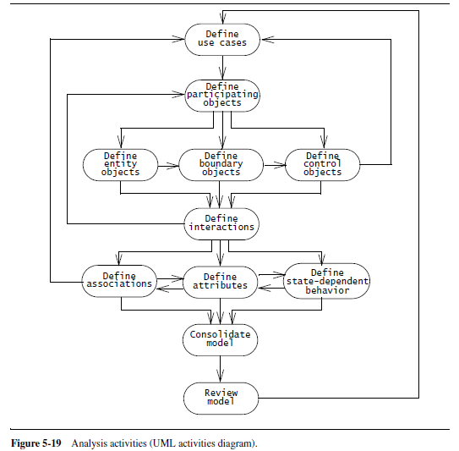
Analysis Summary

Slide 52
Managing Analysis – Documenting Analysis
The primary challenge in managing requirements is to maintain consistency while using so many resources.
The requirements elicitation and analysis activities are documented in the Requirements Analysis Document (RAD). During analysis the sections of the above document are revised as ambiguities and new functionality are discovered.
Notes:
Objectives for instruction and expected results and/or skills developed from learning.

Slide 53
Managing Analysis – Documenting Analysis/2
The object model documents in detail all the objects identified with their attributes and associations.
The dynamic model documents the behaviour of the object model by means of statechart diagrams and sequence diagrams.
The revision history of the RAD will provide a history of changes, including the author responsible for each change.
Notes:
Objectives for instruction and expected results and/or skills developed from learning.

Slide 54
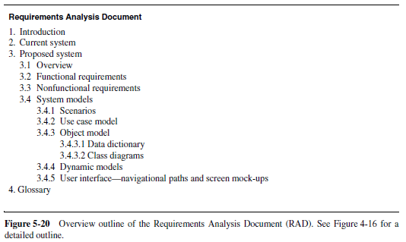
Managing Analysis – Documenting Analysis_2
Notes:
Objectives for instruction and expected results and/or skills developed from learning.

Slide 55
Assigning Responsibilities
Analysis requires the participation of a wide range of individuals:
The target user provides application domain knowledge.
The client funds the project and coordinates the user side of the effort.
The analyst elicits application domain knowledge and formalizes it.
Developers provide feedback on feasibility and cost.
The project manager coordinates the effort on the development side.
Notes:
Objectives for instruction and expected results and/or skills developed from learning.

Slide 56
Assigning Responsibilities/2
For large systems, many users, analysts and developers may be involved, introducing additional challenges during integration and communication requirements. These challenges can be met by assigning well-defined roles and scopes to individuals.
There are three main types of roles:
generation of information,
integration and
review.
Notes:
Objectives for instruction and expected results and/or skills developed from learning.

Slide 57
Client sign-off
Represents the acceptance of the analysis model (as documented by the requirements analysis document) by the client. The client and the developers converge on a single idea and agree about the functions and features that the system will have.
In addition, they agree on:
a list of priorities
a revision process
a schedule and a budget.
a list of criteria that will be used to accept or reject the system
Notes:
Objectives for instruction and expected results and/or skills developed from learning.

Slide 58
Client sign-off/2
Notes:
Objectives for instruction and expected results and/or skills developed from learning.

Slide 59
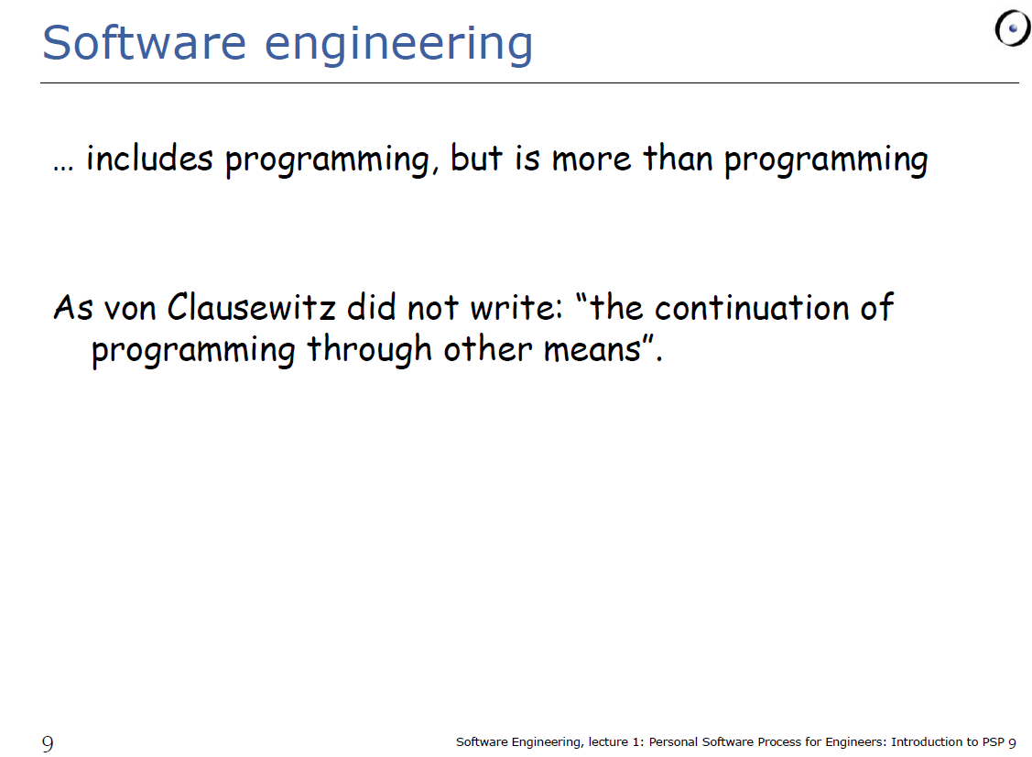
SE is … more than programming
Notes:
Objectives for instruction and expected results and/or skills developed from learning.

